Slide 1
CUSTOMER SEGMENTATION ANALYSIS
Edubridge Project
Presented By : Rejitha Ramesh

Slide 2
PROBLEM STATEMENT
The problem to be in investigated in this customer segmentation is the best application of unsupervised learning. Using clustering, identify segments of customers in the dataset to target the potential user base. They divide customers into various groups according to common characteristics like gender, age, interest, and spending habits so they can market to each group effectively.

Slide 3
INTRODUCTION
In customer, customer segmentation is the process of dividing a broad consumer or business market, normally consisting of existing and potential customers, into subgroups of consumers based on some type of shared characteristics.
A case requires to develop customer segmentation to give recommendation like saving plans, loans, wealth, management, etc. on target customers groups.

Slide 4
ABOUT DATASET
ABOUT DATASET
The sample Dataset summarizes the usage behavior of about 9000 active credit card holders during the last 6 months. The file is at a customer level with 18 behavioral variables.
Variables of Datasets are: Balance, Balance Frequency, Purchase, Cash Advance, Purchases Frequency, Credit Limit, Payments, Tenure, Minimum Payments, etc.

Slide 5
TECH TOOLKIT USED
Python: Python is the programming language
which is used to code the project. Various
algorithms used are coded in python.
Jupyter Notebook: Jupyter notebook is the effective IDE used for coding in python. It is very easy to use and widely used over the industry.

Slide 6
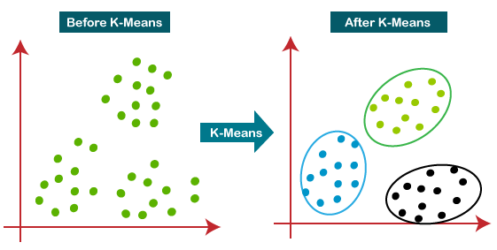
ALGORITHMS USED IN THE PROJECT
Here we have used k-means clustering algorithm, which is part of Unsupervised Learning Algorithm.
It is an iterative algorithm that divides the unlabeled dataset into k different clusters in such a way that each dataset belongs only one group that has similar properties.

Slide 7
HOW DOES THE K-MEANS ALGORITHM WORK?
Step-1: Select the number K to decide the number of clusters.
Step-2: Select random K points or centroids. (It can be other from the input dataset).
Step-3: Assign each data point to their closest centroid, which will form the predefined K clusters.
Step-4: Calculate the variance and place a new centroid of each cluster.
Step-5: Repeat the third steps, which means reassign each data point to the new closest centroid of each cluster.
Step-6: If any reassignment occurs, then go to step-4 else go to FINISH.
Step-7: The model is ready.

Slide 8
METHODOLOGY
First of all we will import all the necessary libraries or modules (pandas, numpy, seaborn).
Data pre-processing
Exploratory Data analysis
Model Building
Model Deployment

Slide 9
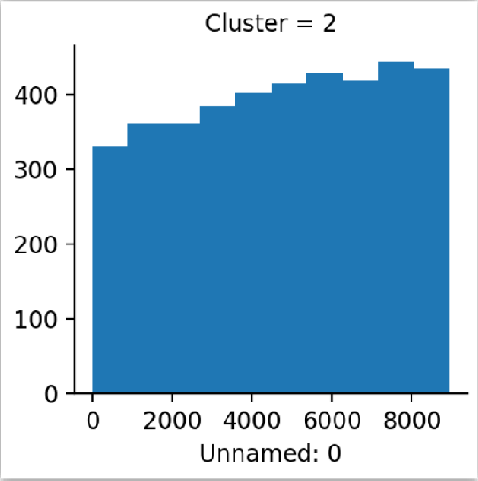
EXPLORATORY DATA ANALYSIS
Overall Analysis
The visual shows the
overall analysis and it
belongs to cluster 2 and
the highest frequency
is for 7000 and lowest for 0.

Slide 10
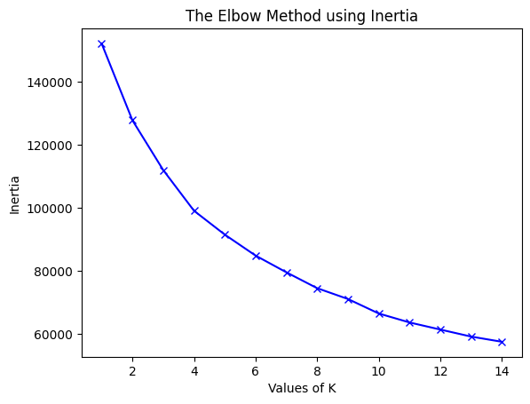
Elbow Method
So from the graph we observed that the at 4 there is bend and it can be considered as k which is no of clusters.

Slide 11
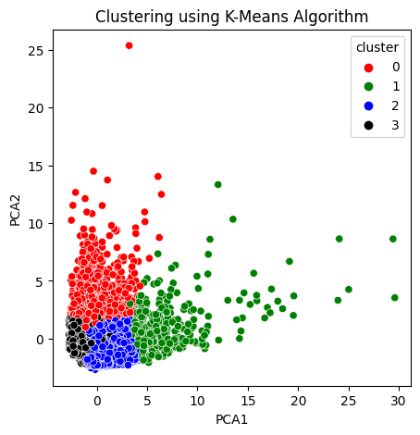
Scatterplot Analysis
A scatterplot is a visualization technique we can perform PCA and we can see four different clusters that has been form.

Slide 12
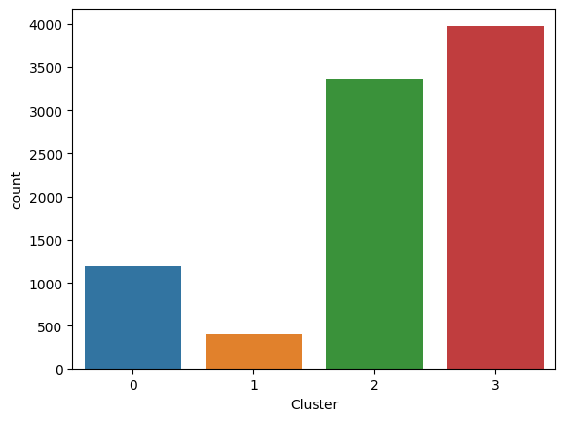
Countplot Analysis
A countplot is a visual representation of the cluster 0 and 1 has the highest number of data points. Cluster 2 and 3 are having the lowest data points.

Slide 13
INFERENCE
In this project, segments of customers are created using the k-means clustering model and analyzed the dataset, in various ways. Visualization of the data set has been done for the better understanding about all the elements and its relation between the data. We used a clustering approach called K-means clustering, in particular. k means clustering is one of the most popular clustering methods, and it's frequently the first thing practitioners try when they're working on a clustering problem. k- means are used to divide data points into discrete, non overlapping groupings.

Slide 14
Thank You

